Slide 1
Dr. Map
Preventive doctor within your hands

Slide 2


What
Awareness Highlight widespread diseases , precautions and symptoms
Intuitive Mapping Choropleth maps - uniquely shaded
Real Time Statistics Provide a simple unifying interface
Alert System Users are notified
Periodic Maintenance + Bug Fix
Multi-lingual support

Slide 3
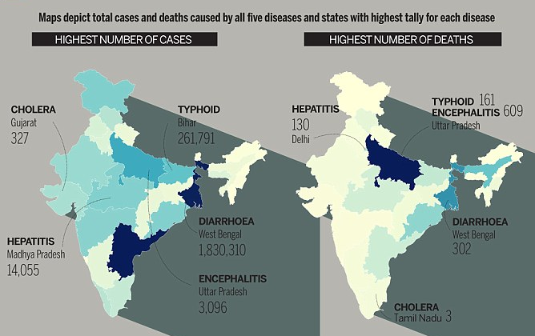
One stop guide to prevention

Slide 4
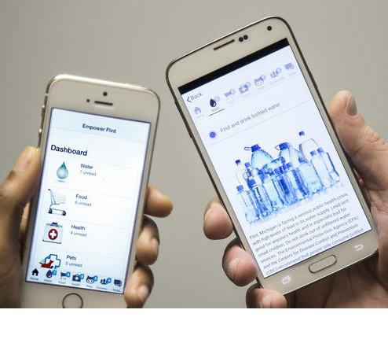
Key Elements
Data collection
Display statistics
Data counter check
Epidemic prediction
Notification broadcasting

Slide 5
Benefits
Notification of disease outbreak
Stock medicines beforehand
Govt can get early prediction
Govt directly gets reports
Multi lingual support

Slide 6
Why Not?
Prevention is better than cure
One stop app to fight diseases
Multi-lingual support for everyone

